Slide 1
Incremental Model (JAD)
Presented by: Shesha, Pooja, Shreya, Liesl.

Slide 2
Collects requirements while building a new information system for any organization
It engages the client and/or the end-users to design and develop the system.
What is JAD?
Designed by Dr. Chuck Morris & Dr. Tony Crawford in 1970s.
Notes:
Joint Association Development collects business and system requirements while building a new information system for any organization or enterprise.
It approaches Software development in a way that engages the client and/or the end-users to design and develop the system.
This model was designed and put forward by Dr. Chuck Morris and Dr. Tony Crawford of IBM, who propose this model in the late 1970s.

Slide 3
What is Incremental Software Development Model?

Slide 4
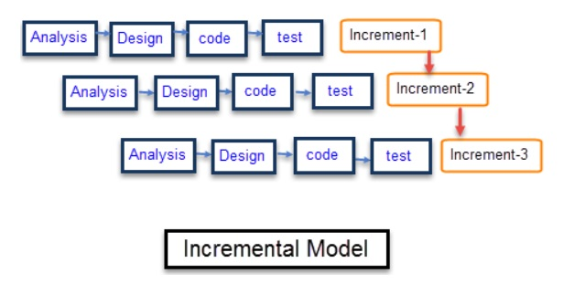
Created in 1950s
Iterates through phases
Functionality is added after each incrementation
The first increment is the core increment
Developments plans are made after each increment.
Documentation takes place
Notes:
Incremental aka iterative development is viewed as a modern practice, its application dates as far back as the mid-1950s. Many large projects used them successfully.
Each iteration passes through the requirements, design, coding and testing phases.
Each subsequent release of the system adds functionality to the previous release until all designed functionality has been implemented.
The system is put into production when the first increment is delivered.
The first increment is often a core product where the basic requirements are addressed, and supplementary features are added in the next increments.
Once the core product is analyzed by the client, there is plan development for the next increment.

Slide 5
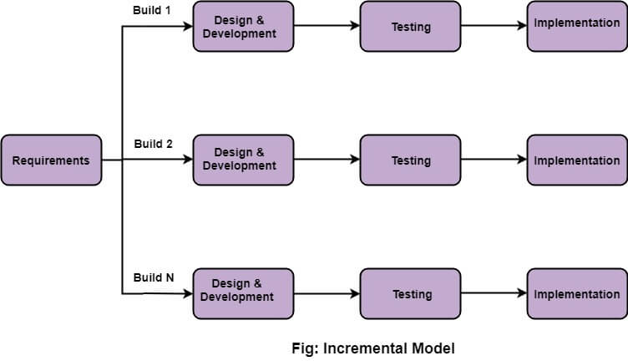
DIAGRAM

Slide 6
WORKFLOW OF INCREMENTAL MODEL
Requirement Analysis
Design and Development
Testing
Implementation
Notes:
It is the first phase of the incremental model, the BA identifies the requirements. The functional requirements are understood by the requirement team. This performs the crucial role.
In this process, the design of the system is made.
The testing phase checks the performance of each existing function as well as additional functionality. In the testing phase, the various methods are used to check the behavior of each task.
Implementation phase enables the coding phase of the development system. It involves the final coding that design in the designing & development phase & test the functionality in the testing phase. After completion of these phase, the number of the product working is enhanced & upgraded to final system product.

Slide 7
Advantages
Errors are easy to be recognized.
Easier to test and debug
More flexible.
Simple to manage risk because it handled during its iteration.
The Client gets important functionality early.
Notes:
Because it helps us to develop and analyze the requirements easily.
It helps in reducing unnecessary costs during development.

Slide 8
Disadvantages
Need good planning.
Total cost is high.
Well defined modules interface are needed.
Notes:
Rectifying a problem in one unit requires correction in all the units and consumes a lot of time.
It is not suitable for small projects as it expensive. It’s much more complex than other SDLC models
Each phase of iteration is rigid and do not overlap each other.
Needs a complete and clear definition of the whole system before it can broken down and built immediately.

Slide 9
Real time example of Incremental Model:
An example of incremental model is
WhatsApp
Chats >> Voice Call >> Status Update >> Video Call
Windows
It upgrades it version through Integration Model
MS Office
It keeps upgrading as per peoples opinion
Notes:
How do we know if a project needs it?
The detail software requirements are needed

Slide 10
Thank You!

